Slide 1
Dystopia v. Utopia
Fahrenheit 451
by
Ray Bradbury

Slide 2
Dystopia
An imaginary place or state in which the condition of life is extremely bad, as from deprivation, oppression, or terror.

Slide 3
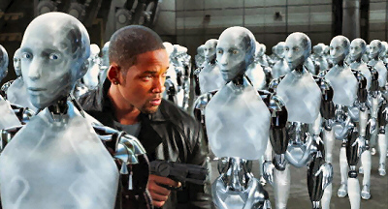

Slide 4
Utopia
Any real or imaginary society, place, state, etc. considered to be perfect or ideal
Any visionary system of political or social perfection
An ideal place or state
Dictionary.com

Slide 5
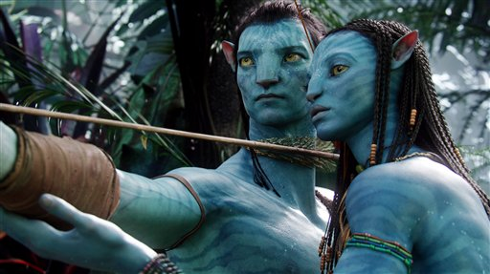

Slide 6
Characteristics
 | Dystopia | Utopia
Society | Classes, caste system | Equality of all people
View on future | Pessimistic, negative | Optimistic, positive
Education | Propaganda, information spread to help or harm group or society | Equal and advancing education
Economy | Rich and poor, no middle class | No money, equal distribution of goods

Slide 7
Create Your Utopia
As a class, you will create a Class Utopia
Need butcher paper and markers
In your designated group, you will be responsible to create the chosen aspect of your Utopia.
Write the Utopia category at the top- use big letters
Use pictures, symbols, and bullet points to describe your Utopian category (be creative)
Make sure to answer the guided questions within your group on your butcher paper
All participants be prepared to report your Utopian aspect to the class on Wednesday

Slide 8
Group Utopia Rubric
1 point- Title in large print at the top of paper
3 points- Answering all guided questions
4 points- Creativity, use of pictures, symbols, colors
1 point- All members names on chart
1 point- All members present
10 Total Points

